Slide 1

Planning & control of a 4 -DOF manipulator using inverse kinematics
Names | Affan Bin Usman | Vishnu T. P | Vihari Gandrakota | Sidhant Das
Asurite ID | ausman4 | vpishara | vgandrak | sdas116

Slide 2
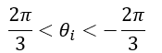
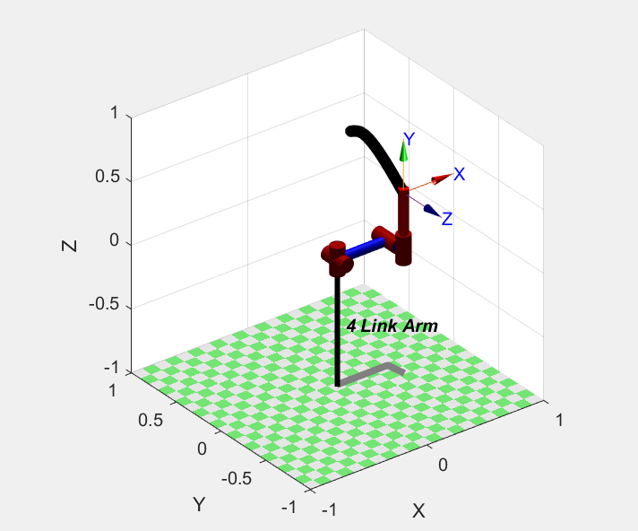
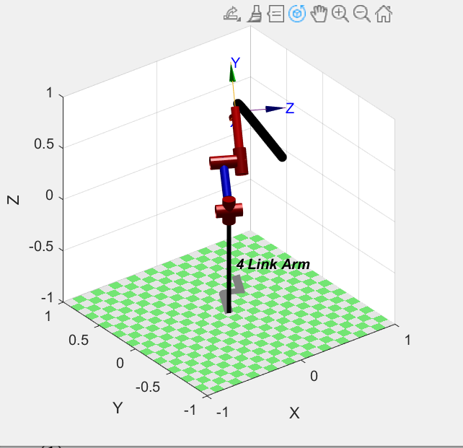
PROBLEM STATEMENT
Considering a 4-DOF manipulator with all the 4 joints as revolute and assuming certain DH parameters for the manipulator, we want the manipulator to navigate from an initial pose to a desired final pose.
Final pose
Trajectory
Initial pose

Slide 3
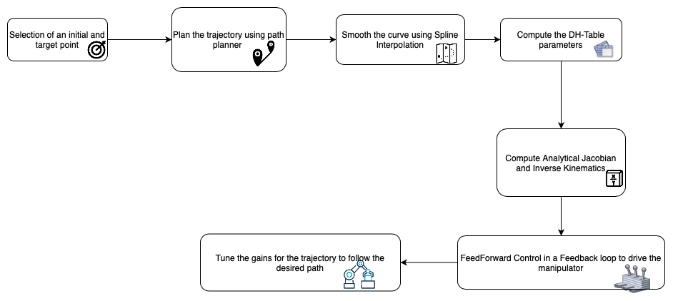
PROCESS FLOW

Slide 4
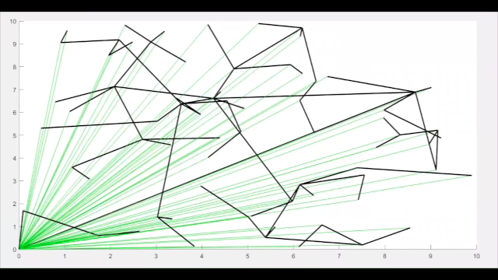
RRT*
Notes:
Rapidly exp random trees as the name says selects a random nodes and connect to the growing tree if the constraints are satisfied and no obstacles are on the way. RRT* is a more optimal version where it is made sure that the random node get attached to the best neighbour node. Similar implementation can also be done in 3D space for planning the path for the manipulator.

Slide 5
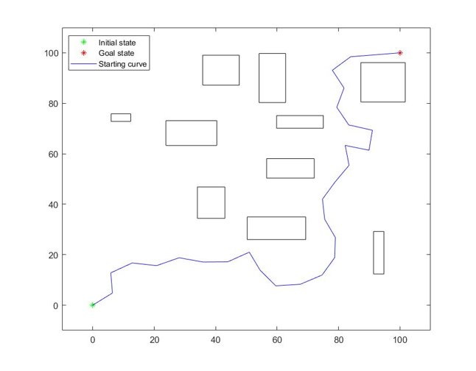
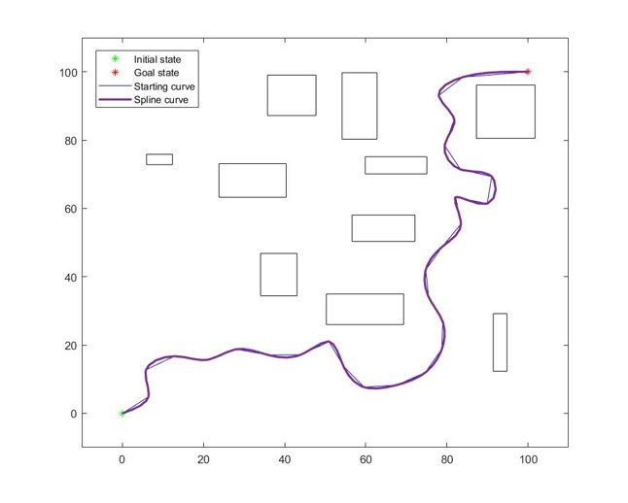
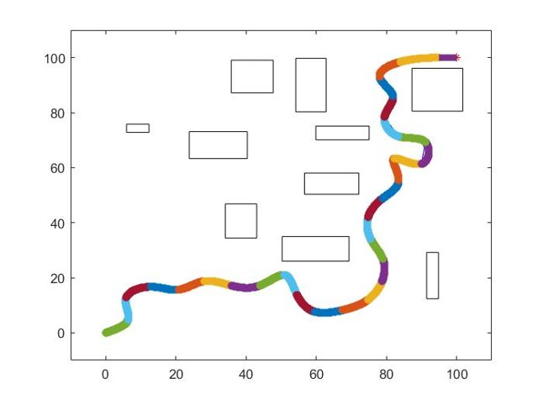
Interpolation
Notes:
However the plotted traj might not be smooth which might impeded the traj tracking therefore, it is smoothen using spline

Slide 6
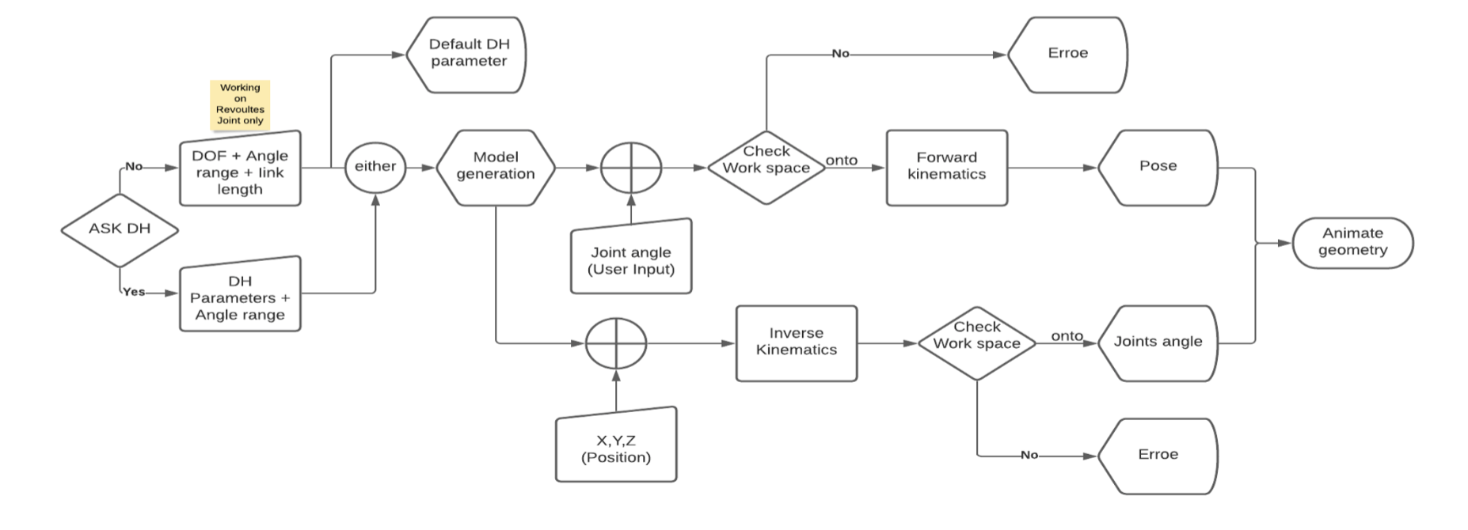
Working schematics

Slide 7
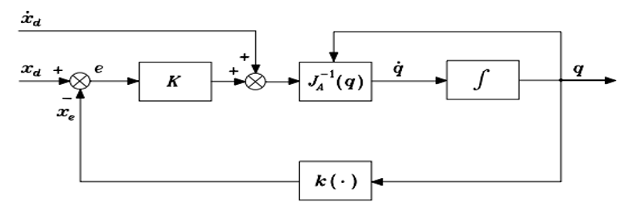
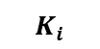
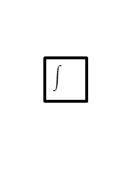
Controller
Proportional Integral Controller
+
$$K_{i}$$

Slide 8

DEMO
Notes:
Here is an implementation of our code. AS it can be observed the manipulator is trying to follow the planned trajectory.

Slide 9
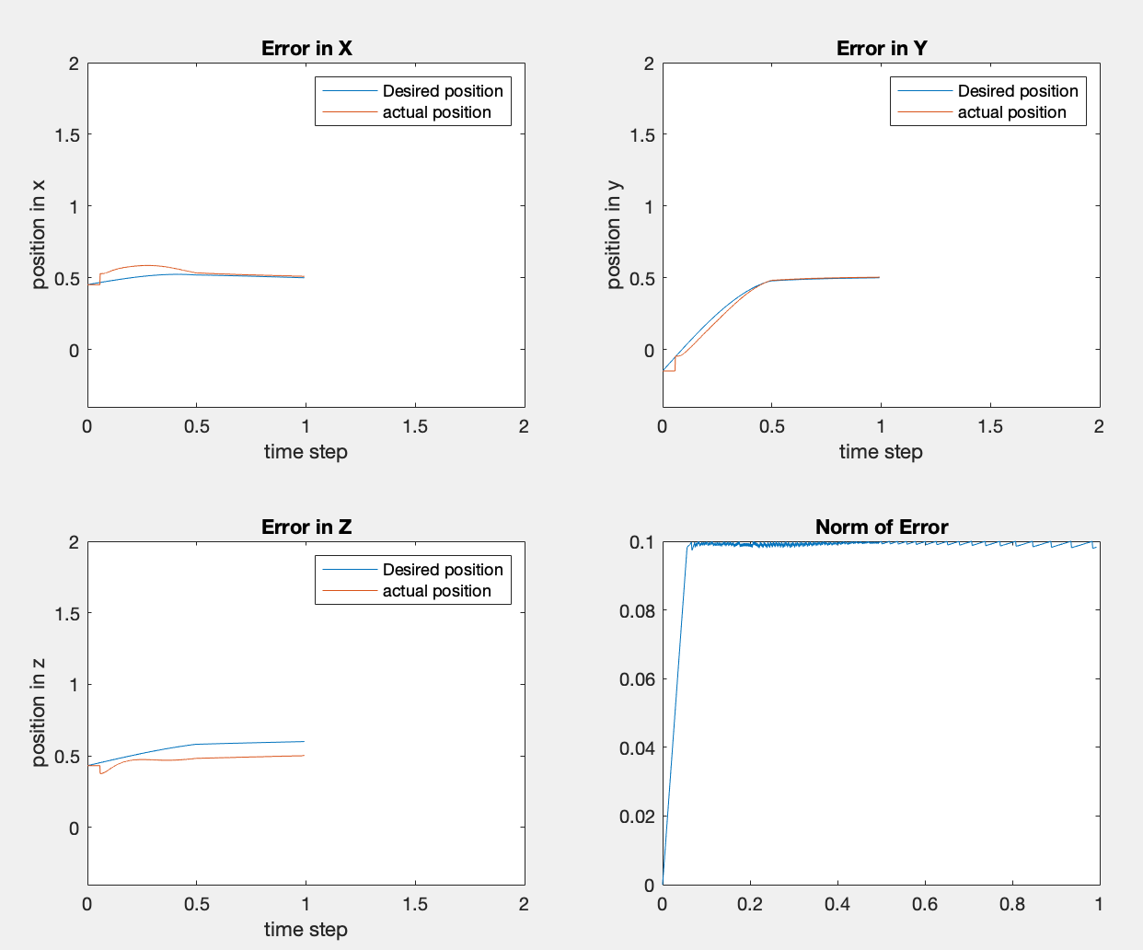
Results
The end effector of the manipulator was able to reach the desired pose following the desired trajectory.
Some initial deviation from trajectory is observed but after certain time the controller is able to make the manipulator follow the desired trajectory.
Some steady state error does exist since its just a proportional controller
Notes:
The manipulator was able to reach the end effector pose with minimal error, as shown in the norm of error in the bottom right plot.
We do observe some initial deviation in the beginning. However, the controller is able reduce the deviations after a few time stamps.
Furthermore, we also observe some steady state error due to the nature of the controller.

Slide 10
Code Description
The following functions have been defined and implemented in our code:
rrt_star_plan_obs Plans the path from the start point to the goal coordinates.
forward_kinematics Finds the transformation matrix from base frame to end effector frame.
analytical_jacobian_val gives the analytical jacobian if the input joint positions are inputted.
workspaceforproj Plots the workspace of the manipulator
ellipse_plot To find and plot the velocity ellipsoid in 3D.
Controller Parameters Proportional gain=30 & Integral gain=0.05

Slide 11
Steps for Execution
Software Used: MATLAB
MATLAB Packages To Be Installed
RRT and RRT* for 3D --- https://www.mathworks.com/matlabcentral/fileexchange/105615-rrt-and-rrt-for-3d
2D/3D RRT* algorithm --- https://www.mathworks.com/matlabcentral/fileexchange/60993-2d-3d-rrt-algorithm
Curve Fitting Toolbox version 3.6 by MathWorks
Statistics and Machine Learning Toolbox version 12.2 by MathWorks
Robotic Toolbox for MATLAB version 10.4 by PETER CORKE
The above files can be added using MATLAB add on manager either directly through the manager or going to the above link and installing it
to the MATLAB add on manager.
If the files are downloaded using the link not on MATLAB but somewhere in system, they must be first saved in the execution folder.
Steps To Run The Code:
run file named finalcode.m (type finalcode in the MATLAB command window after making sure the file is added to the path)
Provide the inputs as indicated.

Slide 12
Discussion
Challenges of implementing inverse-kinematics from scratch.
Drawbacks of existing controllers.
How these drawbacks can be overcome through other approaches.
How this work can be extended to arms with multiple joints and higher DOF.
The Kinematic model can be incorporated with a dynamic controller, in an adaptive manner.
Algorithms like particle swarm optimization can be used to compute inverse kinematics without using analytical Jacobian.
Notes:
As for improvements in the current working, we can
Implement a Kalman filter algorithm for better trajectory tracking
The Kinematic model from this project can be incorporated with a dynamic controller, in an adaptive manner. So as to obtain better tracking results, even when encountered with parametric disturbances.
Randomization of obstacle can also be done for checking the robustness of controller.
And using alternative approaches like particle swarm optimization or reinforcement learning, will be more useful for complex models.,

Slide 13
Team Contributions
Team Member Name | Contribution | Contribution Percentage
Affan Bin Usman | Velocity ellipsoid, App designer - GUI Design, Trying implementation of OpenMANIPULATOR-X on Ubuntu (18.04) ROS (melodic), Workspace, Code integration | 25%
Vishnu T. P | RRT, Trajectory planning, PI Controller, Presentation, Inverse Kinematic algorithms, Code integration | 25%
Vihari Gandrakota | Research on different inverse kinematic algorithms, Analytical Jacobian, Trying implementation of OpenMANIPULATOR-X on Ubuntu (18.04) ROS (melodic), Presentation, Code integration | 25%
Sidhant Das | Transformation matrix calculation, Computation of DH parameters, N-DOF robot making interactive code, Presentation, Workspace, Code integration | 25%
Our team met on a weekly basis to discuss theory behind our project & the execution of the code to that theory. Each member of the team has had full attendance & participation within each of these project meetings.

Slide 14
Thank You!

